Slide 1
Lab1
Socket programming with TCP

Slide 2
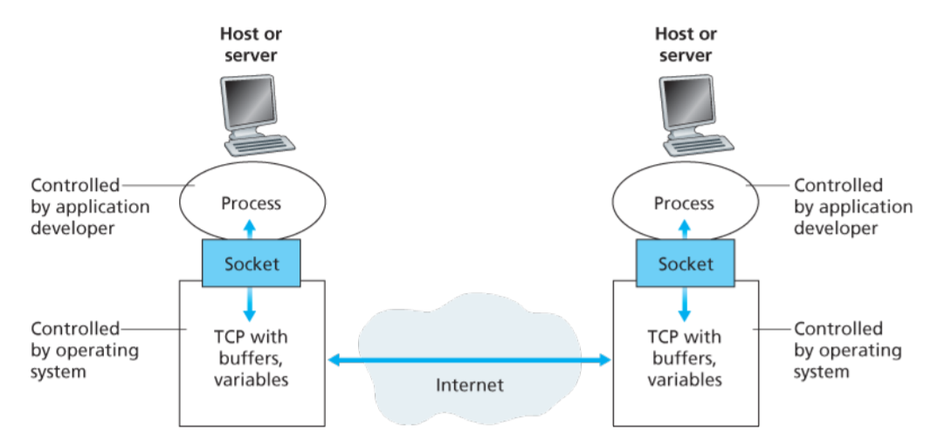
Socket – software interface used by processes to send (and receive) messaged through the network
Figure source: Computer networking a top down approach featuring the internet, J. Kurose and K. Ross

Slide 3
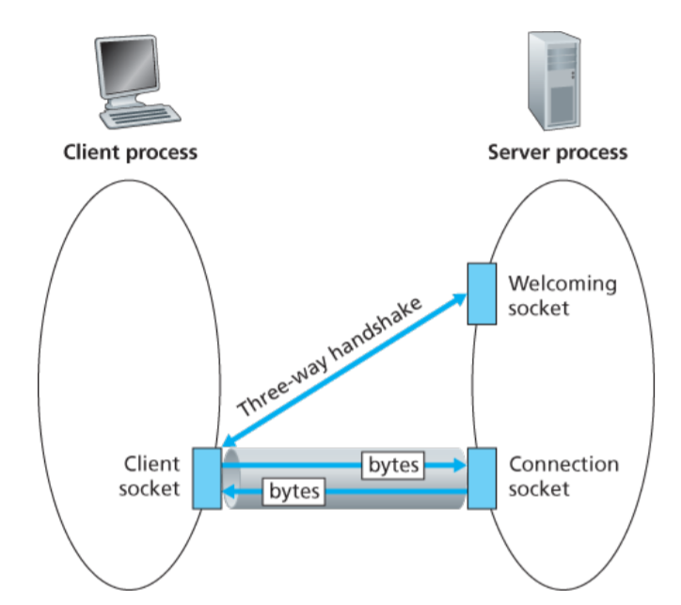
Figure source: Computer networking a top down approach featuring the internet, J. Kurose and K. Ross

Slide 4
